Slide 1



Carbon Emissions Prediction Using Machine Learning
A Data-Driven Approach to Understanding and Forecasting CO₂ Emissions
By: Madhumitha H
student Id:STU664b7d741b2f01716223348

Slide 2

Learning Objectives
Understand the trends and patterns in global carbon emissions over time.
Explore, clean, and engineer features from raw environmental datasets.
Apply regression-based machine learning to predict CO₂ emissions.
Evaluate model performance using appropriate metrics (R², RMSE).
Interpret which energy and economic indicators contribute most to emissions.
GOAL
Source :
www.freepik.com/

Slide 3





Tools and Technology used
Languages: Python
Libraries:
Pandas & NumPy (Data handling)
Matplotlib & Seaborn (Visualization)
Scikit-learn (Modeling & Evaluation)
ENVIRONMENT:
Jupyter Notebook: For development & experimentation
GitHub: For version control
VS Code/Terminal: Project organization

Slide 4
Methodology
Step 1: Data Cleaning – Removed missing values and ensured consistency.
Step 2: Data Exploration – Visualized emission trends by year, country, population, GDP, etc.
Step 3: Feature Engineering –
Created CO₂ per capita, energy per capita, and energy per GDP features.
Goal: Find which unit (total, per capita, per GDP) is most insightful.
Step 4: Model Building –
Used Random Forest Regressor.
Applied Train/Test split.
Evaluated model using R² and RMSE.

Slide 5
Problem Statement:
Global CO₂ emissions are rising, worsening climate change.
Raw data is often messy, with missing values and inconsistent formats.
It's unclear which CO₂ metrics (per capita, per GDP, total) give the best insights.
There’s a need for a predictive model that links energy usage and economic data to CO₂ emissions.
The goal is to support green policies with accurate predictions and clear insights.
Industries and governments require data-driven tools to measure impact.
Manual analysis of such complex data is time-consuming and error-prone.
A well-structured ML pipeline can simplify interpretation and aid better decision-making

Slide 6
Solution:
designed a complete pipeline from data cleaning to model building using Python.
Performed exploratory data analysis (EDA) to understand trends, spot missing data, and derive insights.
Implemented feature engineering to create meaningful variables like energy use per capita, per GDP, etc.
Selected Random Forest Regressor, a robust ML model, to predict CO₂ emissions.
Used train-test split and cross-validation to ensure model reliability and avoid overfitting.
Evaluated using R² and RMSE scores — achieving 98% test accuracy, showing high model performance.
Visualized actual vs predicted emissions and trend lines to make findings interpretable.
Output insights help identify which type of CO₂ metric (per capita, GDP, or total) reflects impact best.
This approach enables data-driven policy formulation and sustainability benchmarking

Slide 7
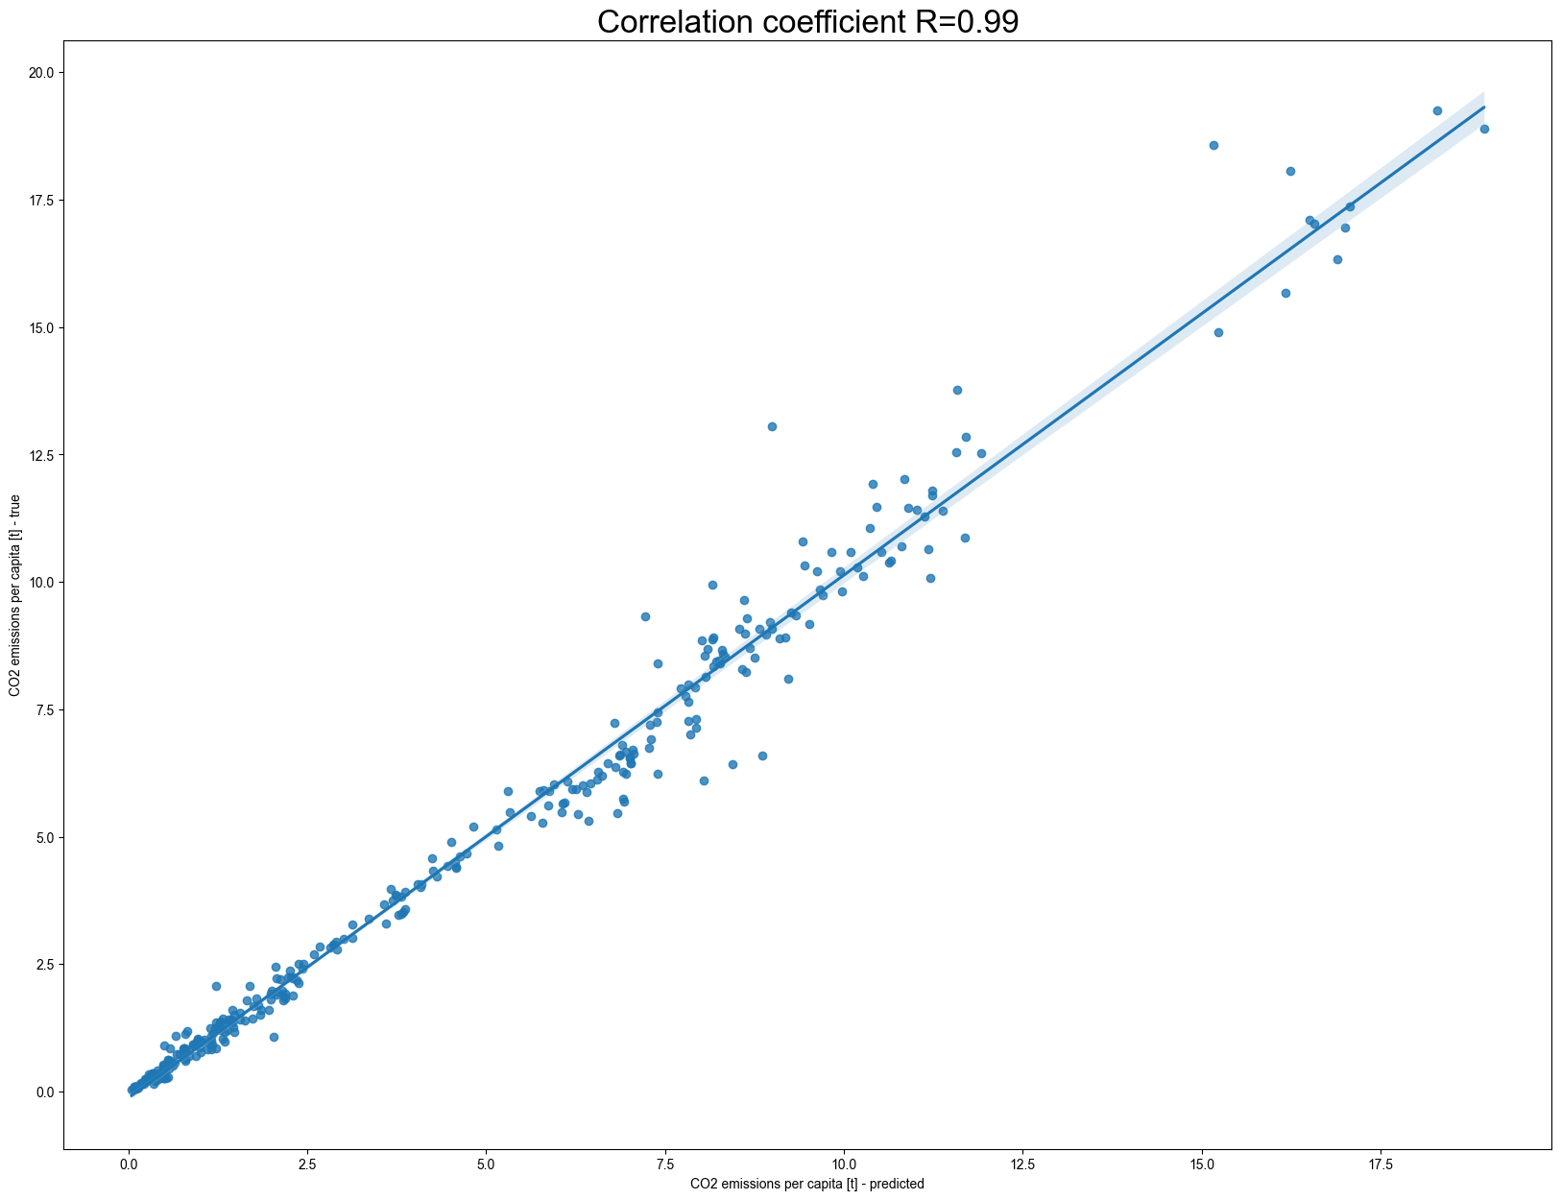
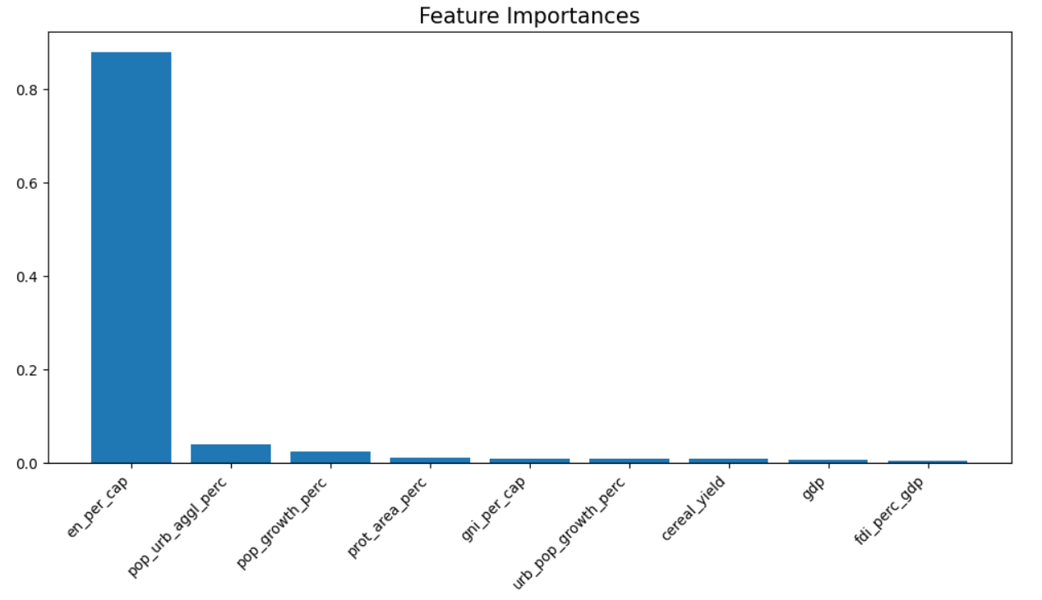

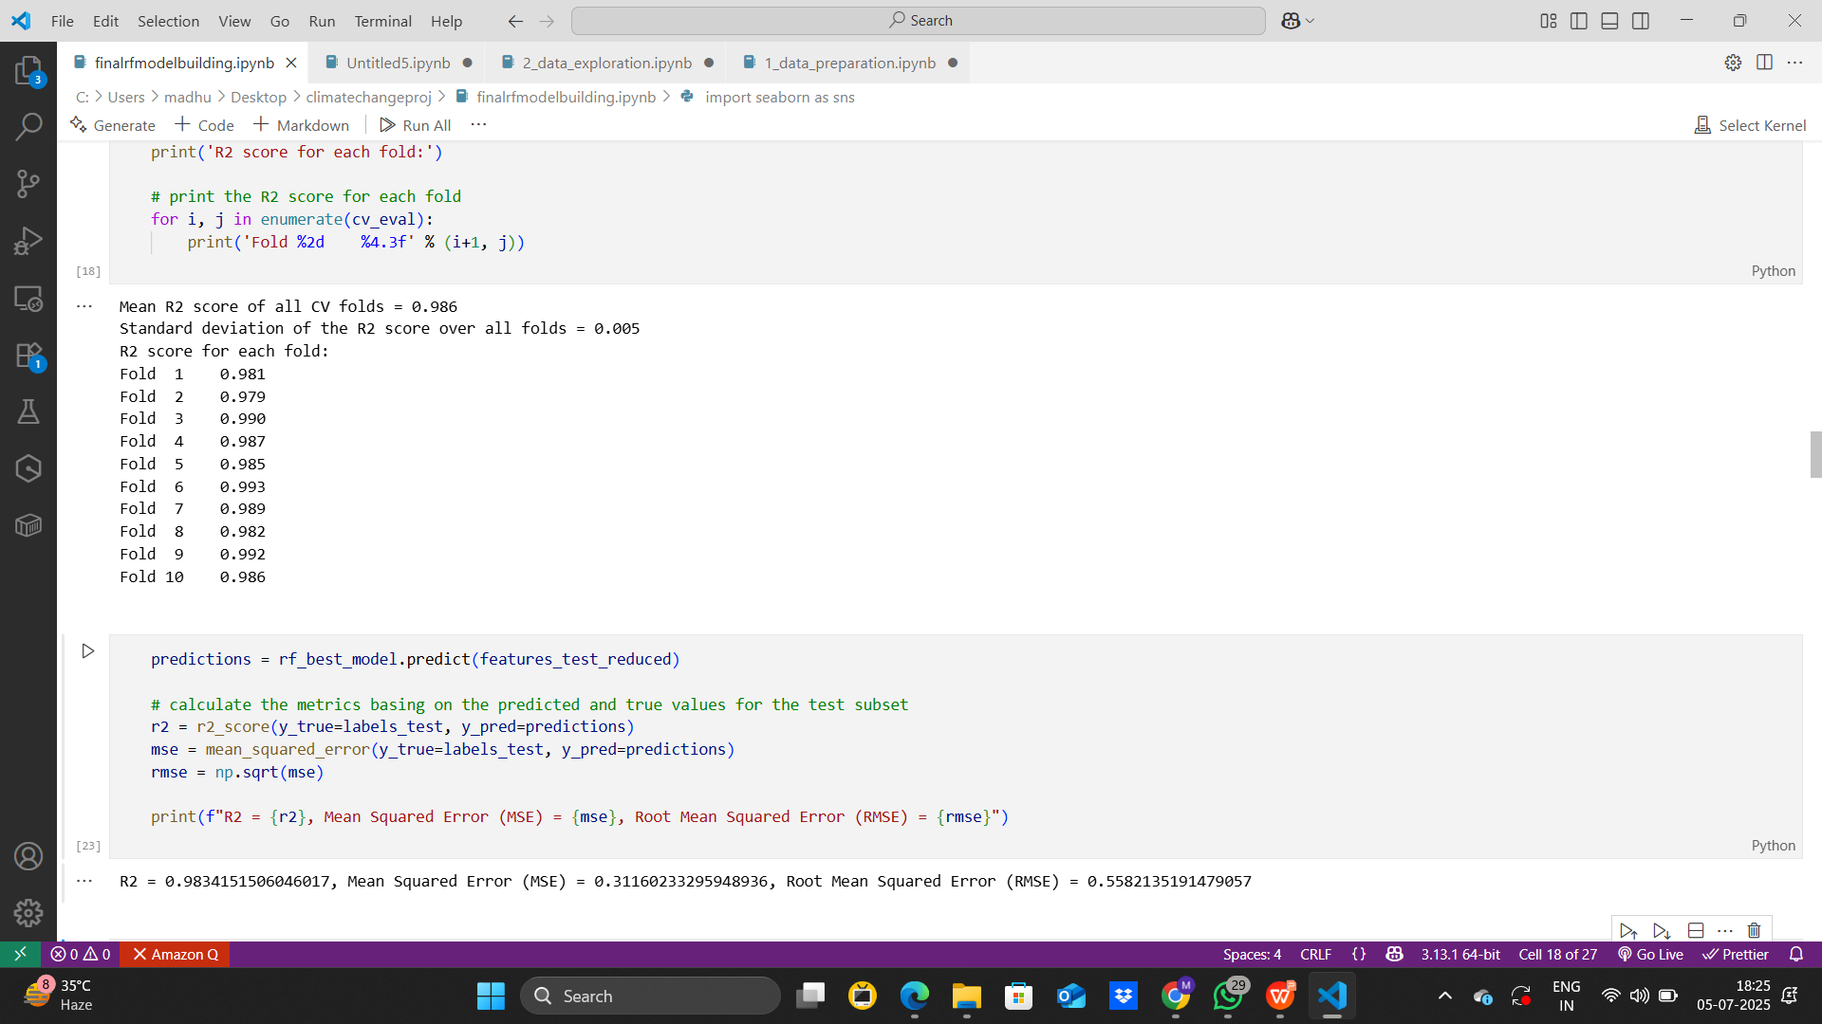
Screenshot of Output:

Slide 8
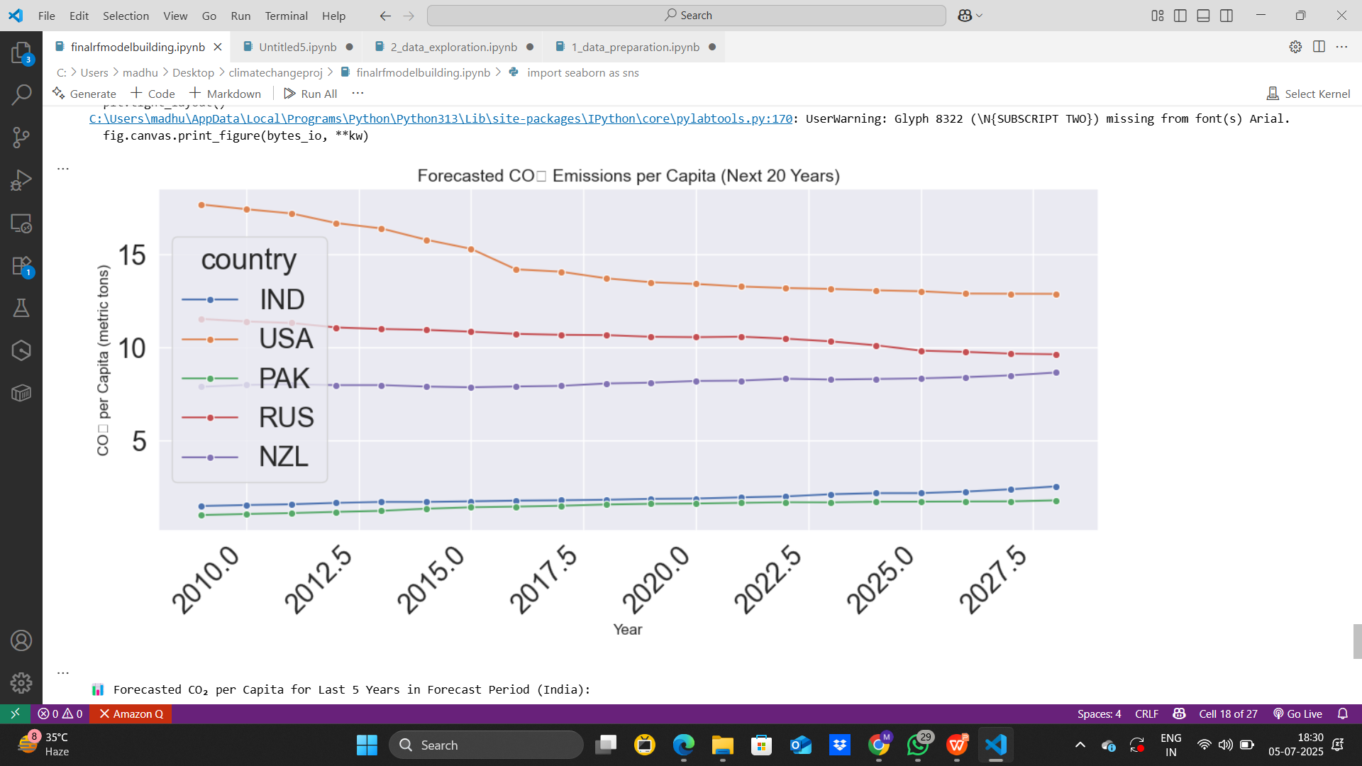
Future CO₂ Emissions Forecast (Next 20 Years)
This chart visualizes the long-term predictions of CO₂ emissions per capita.
Helps understand whether a country is on track to reduce its carbon footprint.
For example, the USA shows a steady decline, while other countries have slower changes.

Slide 9
🔍 Insights Gained
Countries with higher energy efficiency tend to have lower CO₂ emissions per unit GDP, showing sustainable economic growth.
Per capita energy consumption and CO₂ emissions give a clearer picture of individual environmental impact than total emissions.
GDP-based comparisons helped identify nations balancing development with environmental responsibility.
Heatmaps and correlations showed strong relationships between population, energy use, and CO₂ emissions, validating key feature selections.
Machine learning can accurately predict emissions, offering potential for real-time environmental monitoring and policy guidance.

Slide 10
⚠️ Challenges Faced
Initial dataset had inconsistent column names, missing values, and wide year-based format, requiring thorough data cleaning & reshaping.
Had to decide which CO₂ emission metrics (total, per capita, per GDP) were most meaningful for modeling.
Feature engineering required deep understanding of economic-environmental relationships to create impactful new features.
Ensuring model didn’t overfit despite very high R² was challenging—addressed using train/test split and validation.
Pushing the project to GitHub and organizing the workflow took extra effort due to merge conflicts and syncing issues.

Slide 11
🔮 Future Improvements & Scope
Include more recent datasets (post-2011) to reflect modern emission trends and policy changes.
Integrate socio-economic indicators (like urbanization, industrial output) for more accurate predictions.
Add country-specific models to tailor predictions and insights for individual nations.
Time-series forecasting models (like LSTM or ARIMA) could enhance long-term prediction accuracy.
Interactive dashboards (using tools like Power BI or Tableau) can help policymakers explore CO₂ data more intuitively.

Slide 12
“Towards a Greener Future with Data”
Thank You!
Madhumitha H
Intern – Carbon Emission Prediction Project
GitHub: github.com/madhuh1210/carbonemissionprediction-intern

